Slide 1
Mahara & social learning
Dominique Renault
E-Learning Support Officer
Roger Emery
Learning Systems Development Manager

Slide 2
Notes:
Intro to mahara
Basics of what it does
Web 1/ web 2
Student control

Slide 3
Notes:
Our VLE, ePortfolio & online careers site are all integrated where possible:

Slide 4
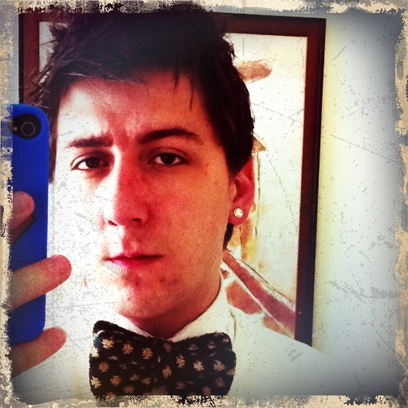
Student Case Study
Name: Chris W
Display name: Winnie
Level: 5 (2nd Year)
Course: BA (Hons) Interior Design (Decoration)

Slide 5
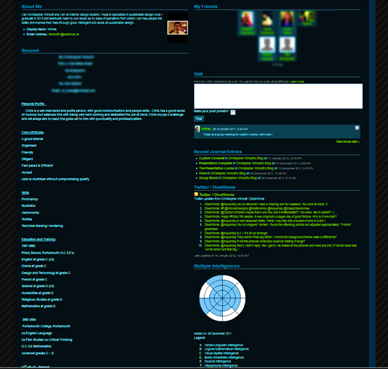
Using external and social content
Users can add friends.
They can also create and control groups
Friends can post wall comments
Twitter feed embedded in the page
Notes:
Friends – can add groups

Slide 6
Linking external content

Slide 7
What did the student think?
“The wall feature is quite cool. You can interact with other people. But I think that’s quite a clever thing to have in there because it does associate, especially with students, it does associate you with Facebook. So that automatically has a social aspect of the portfolio rather than just this is somewhere where you put your work. This is somewhere you can talk to your friends, talk to your lecturers...”
“I enjoyed the fact it is customizable so you can have each segment of your profile page how you prefer it. With Facebook, as an example, sometimes if you put something on there it is up there, you can’t get rid of it. With this [Mahara] it’s nice that you can just alter anything you like.”

Slide 8
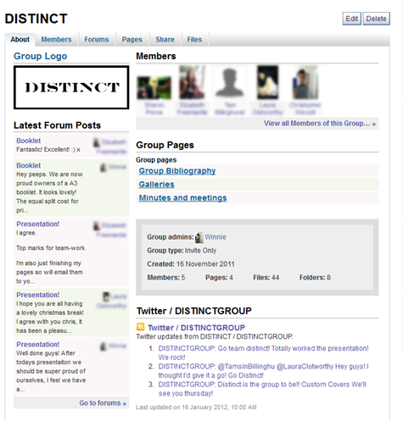
Groups: Content
Sharing
Feeds
Pages
Files
Communication
Forum
Collaboration
Pages
Forum

Slide 9
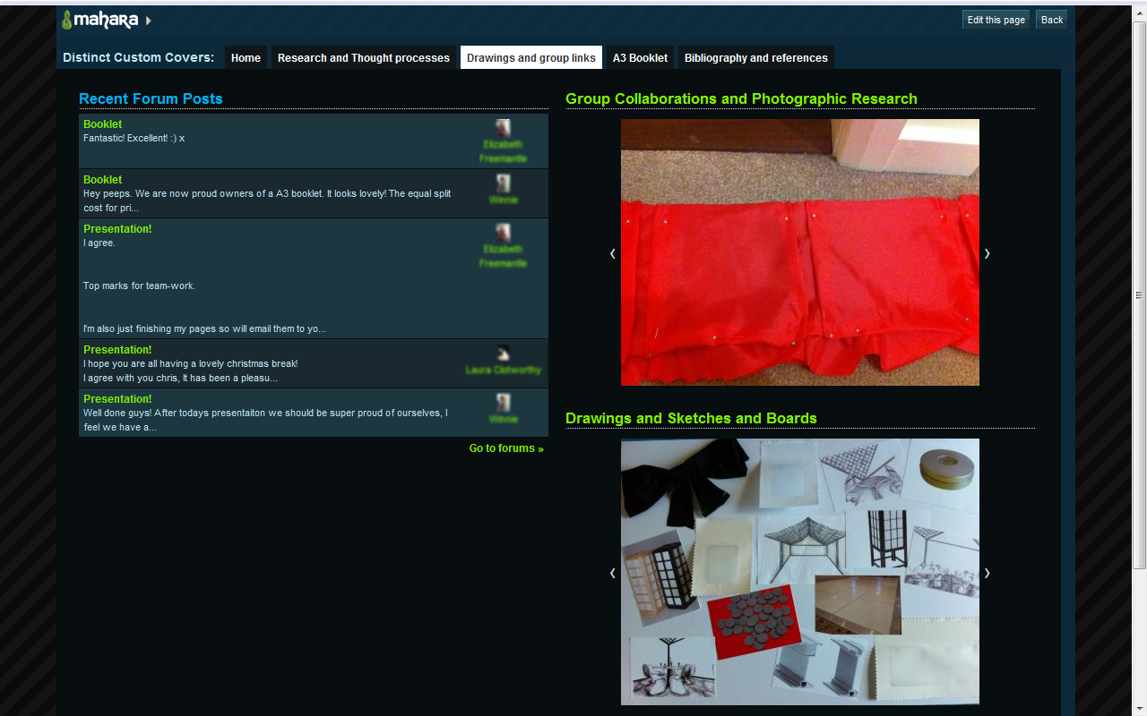
Using group elements on personal pages
Group
Personal

Slide 10
What did the student think?
“I think it’s perfect to have the group on myPortfolio [Mahara] as opposed to Facebook, because if you were to do it on Facebook chances are you get distracted by who’s doing what and Bob’s got a new job or whatever. Whereas on myPortfolio it focuses your mind onto, we’re here to do some work you just happen to have the social aspect as well.”
“My favourite feature of the group page is the fact you’ve got so much scope to grow within that project and as a group. Every time we had something new or another idea we’d post it on there and get everyone else to feedback.”
Most people if you were to ask them what their favourite aspect of uni was it would be the social side. So to include that in the technology available to them is crucial.

Slide 11
Students key points
Promoted team work
High team morale
Mobile
Easy
Focuses
Organise
Communicate
Stress-free

Slide 12
Conclusion
Early Days
Student Control
Safe for Students
System Control
Awareness
Anxiety about initial use
Flexibility
Customisable
Notes:
Conclusion
Still early days – no student gone through entire course with it
System – does give students social media tools for learning in a safe environment
Give the uni some control – we can retrieve backups (we can’t do that with external sites)
Awareness (50% directed by staff) (stats out of 61 people)
Most popular for assessment (46%)
Over half wanted mobile version

Slide 13
Roger Emery
roger.emery@solent.ac.uk
Twitter: @SolentRoger
Domi Renault
dominique.renault@solent.ac.uk
Twitter: @Lilly_Stardust
General email: ltu@solent.ac.uk

